Slide 1
Wireless WANs

Slide 2
Wireless WANs
Wireless WANS are specifically designed for high-throughput; long-distance digital data exchange

Slide 3
Cellular (1 of 2)
Cellular networks were initially designed for analog phone service
Today it can deliver data and voice
Cellular technology generations include the following
1G (first generation) were analog
2G (second generation) used digital transmission up to 240Kbps
3G (third generation) supported data rates up to 384Kbps
Data communications use packet switching
4G (fourth generation) services are characterized by an all-IP network for data and voice
Specifies throughputs of 100 Mbps to 1 Gbps speeds
5G (fifth generation) services require minimum speeds of 1 Gbps and max out at 20 Gbps and upload speeds of 10 Gbps

Slide 4
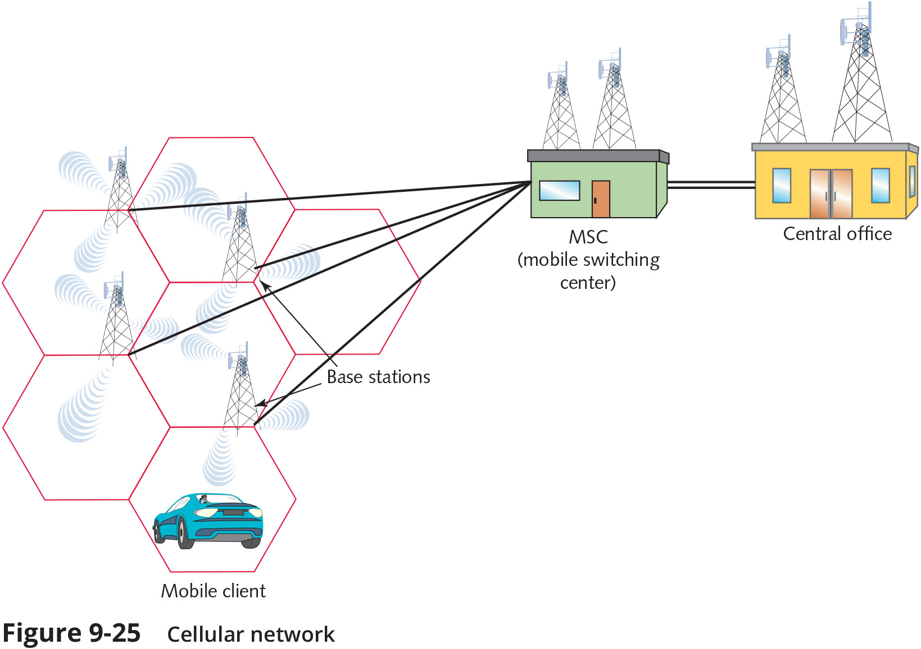
Cellular (2 of 2)

Slide 5
Satellite (1 of 2)
Today, satellites are used for transmitting consumer voice, video, music, and data
Satellite orbits
Most satellites circle the Earth in a geosynchronous orbit
GEO (geosynchronous earth orbit) satellites orbit at the same rate the Earth turns
Information is transmitted to the satellite in an uplink from an Earth-based transmitter
A satellite transponder transmits signal to Earth-based transmitter in a downlink
GEO satellites are the type used by the most popular satellite data service providers

Slide 6
Satellite (1 of 2)
Satellite Internet services
A handful of companies offer high-bandwidth Internet access via GEO satellite links
Satellite services are typically asymmetrical, and bandwidth is shared among many subscribers
Throughputs vary and are controlled by the service provider

Slide 7
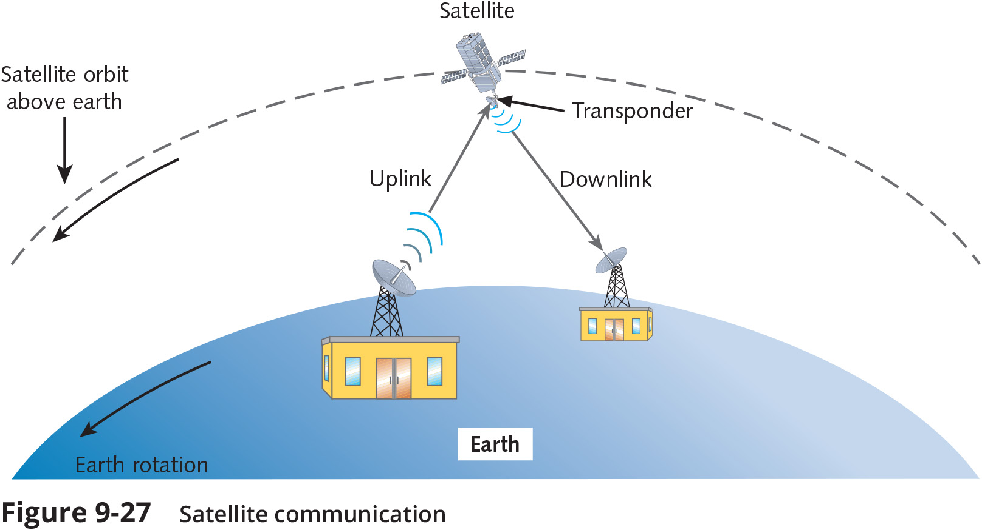
Satellite (2 of 2)

Slide 8
Internet Connectivity Issues
When you lose Internet connectivity, troubleshooting can help determine the location of the problem and the party responsible for repairing the connection
The following list presents some common issues to look for on your own equipment:
Interface error
DNS issues
Router misconfiguration
Interference

